Slide 1

Threads
Presented by:
Elizer Ponio Jr.

Slide 2
The concept of Multitasking
Notes:
Human multitasking is the concept that one can split their attention on more than one task or activity at the same time, such as speaking on the phone while driving a car. Multitasking can result in time wasted due to human context switching and becoming prone to errors due to insufficient attention. If one becomes proficient at two tasks, it is possible to rapidly shift attention between the tasks and perform the tasks well.

Slide 3
Computer Multitasking
In computing, multitasking allows a user to perform more than one computer task at a time. The operating system can keep track of where you are in these tasks and go from one to the other without losing information.
During multitasking, tasks that are not visible to the user are called background while tasks that the user is currently using and is directly visible are called foreground.
Notes:
When referring to multitasking operating systems, the background is the place an active program is running, but not visible to the user.
Foreground refers to the task, process, application, or window on an operating system that the user is currently using.

Slide 4
What are Threads in Java?
Threads allows a program to operate more efficiently by doing multiple things at the same time.
Threads can be used to perform complicated tasks in the background without interrupting the main program.

Slide 5
What is Multithreading?
The process of executing multiple threads simultaneously.
Helps maximum utilization of the CPU.
Each thread are independent, they do not affect execution of other threads.
An exception in one thread will not interrupt other threads
Mostly used for serving multiple clients, multiplayer games or other mutually independent tasks.

Slide 6
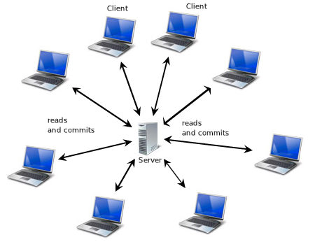
Real world use cases
Server handling multiple requests from different clients simultaneously

Slide 7
Real world use cases
Multiplayer games

Slide 8
Creating a thread
Extending the Thread Class.
Implementing a Runnable interface.

Slide 9
Extending the Thread Class
public class myThread extends Thread {
public void run() {
System.out.println(“Thread is running”);
}
}

Slide 10
Implementing a Runnable Interface
public class myThread implements Runnable {
public void run() {
System.out.println(“Thread is running”);
}
}

Slide 11
Thread Lifecycle
New
start()
stop()
Runnable
stop()
Dead
run()
Running
End of execution
sleep()
stop()
Blocked

Slide 12
Thread Lifecycle
New State. As we use the Thread class to construct a thread entity, the thread is born and is defined as being in the New state.
Runnable State. A thread in the runnable state is prepared to execute the code. When a new thread's start() function is called, it enters a runnable state.
Running State. Running implies that the processor (CPU) has assigned a time slot to the thread for execution. When a thread from the runnable state is chosen for execution by the thread scheduler, it joins the running state.

Slide 13
Thread Lifecycle
Blocked State. When the thread is alive, i.e., the thread class object persists, but it cannot be selected for execution by the scheduler. It is now inactive.
Dead State. When a thread's run() function ends the execution of sentences, it automatically dies or enters the dead state. That is, when a thread exits the run() process, it is terminated or killed. When the stop() function is invoked, a thread will also go dead.

Slide 14
Common Thread Class Methods
Method | Description
run() | Returns the number of active threads
start() | Changes the name of the thread
sleep(milliseconds) | Returns the name of the thread
activeCount() | Returns the number of active threads
setName() | Changes the name of the thread
getName() | Returns the name of the thread
join | Waits for a thread to die
join(milliseconds) | Waits for a thread to die for the specified milliseconds

Slide 15
Common Thread Class Methods
Method | Description
setPriority() | Changes the priority of the thread 1 – lowest priority 5 – default priority 10 – Highest priority
getPriority() | Returns the priority of the thread
isAlive() | Returns true if the thread is active
isDaemon() | Returns true if the thread is a Daemon thread.
setDaemon() | Marks the thread as a daemon or user thread

Slide 16
Daemon Threads
A low priority thread that runs in background to perform tasks such as garbage collection.
All non-daemon threads are referred to as User threads.

